Slide 1

Notes:
1

Slide 2
News Story Structure
A
Most Important Information
Next Most Important
The
Inverted
Pyramid
Next Most Important
Next Most Important

Slide 3
News Writing Structure
Sixteen people died
In a five-alarm fire
In a downtown apartment building
The
Inverted
Pyramid
Next to Interstate 80

Slide 4

News Writing Structure
The Inverted Pyramid structure answers the most important of the reader’s questions in the lead and first few paragraphs
Details are included in following paragraphs for those who want more information

Slide 5

News Writing Style
Basic Rules to follow
  1. Keep the lead short to about 25 words or less
  A news writer will spend a great deal of time getting the lead exactly right

Slide 6

News Writing Style
Basic Rules
  2. Keep following paragraphs short as well.
    News paragraphs are not filled with fluff or extra words
    This is the opposite of creative writing!

Slide 7

News Writing Structure
Basic Rules
  3. News paragraphs are written concisely
    They present information quickly
    They can be one or two sentences in length
    FORGET the five sentence per paragraph rule!

Slide 8

News Writing Style
Basic Rules
  4. Story should always answer the main questions
    WHO, WHAT, WHEN, WHERE, WHY, HOW

Slide 9

News Writing Style
Basic Rules
  5. News should be in ACTIVE not PASSIVE voice
    Passive: Sixteen inches of snow was dumped by the storm
    Active: The storm dumped sixteen inches of snow

Slide 10

News Writing Style
Basic Rules
  6. Writing should be sharp and without extra or redundant words
    Do not use the word really, really!
    The news does not exaggerate

Slide 11

News Writing Style
Basic Rules
  7. Write in THIRD PERSON (he, she) rather than FIRST PERSON (I) or SECOND PERSON (you)

Slide 12

News Writing Style
Basic Rules
  8. Never refer to yourself in a story
    NOT: “I asked her about her favorite class”
    BUT: “Jennifer said her favorite class was science.”
    The reporter should be invisible

Slide 13

News Writing Style
Basic Rules
  9. News stories should never reflect the opinion of the writer
  The writer should be fair, balanced, and objective and only report the facts

Slide 14

News Writing Style
Basic Rules
  10. The only opinion in a news story should be the opinions of others
  All opinions should be attributed or credited to a source
  Direct quotes are best

Slide 15

News Writing Style
Basic Rules
  11. A good news story has several credible sources
    Do not just rely on one source

Slide 16
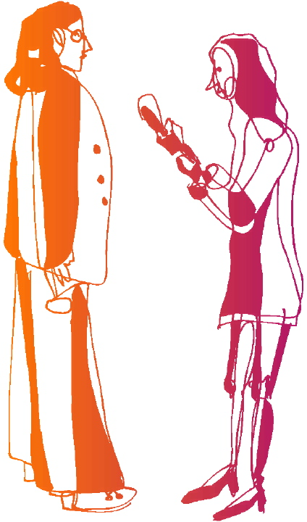
News Writing Style
Basic Rules
  12. Use quotations throughout the story to verify and support the facts of the story

Slide 17

News Writing Style
Types of Quotes
  Direct: Word for word repetition of a source
  Indirect: Rephrasing or restating the words of the source

Slide 18
News Writing Style
Lead-Quote-Transition Inverted Pyramid Style
SUMMARY LEAD
“DIRECT QUOTE”
TRANSITION
“DIRECT QUOTE”
TRANSITION
“DIRECT QUOTE”
TRANSITION
“DIRECT QUOTE”

Slide 19
Notes:
19

Slide 20
Writing a Newspaper Story

Slide 21
Parts of a News Story
Headline – tells what the story is about
Byline – shows who wrote the story
Lead – tells the most important facts (5 W’s)
Body – contains more information and details
Ending – gives something to think about

Slide 22
Parts of a News Story
Headline
Train accident forces evacuation

Slide 23
Parts of a News Story
Headline
Byline
Train accident forces evacuation
By Scott Freed

Slide 24
Parts of a News Story
Headline
Byline
Lead
Train accident forces evacuation
By Scott Freed
A freight train carrying dangerous chemicals collided with a semi-trailer in southwestern Manitoba on Thursday, sending a towering plume of toxic black smoke into the air and forcing the evacuation of more than 100 area residents.

Slide 25
Parts of a News Story
Headline
Byline
Lead
Body
Fifteen of 20 derailed cars at an uncontrolled crossing along CN Rail’s mail line were ablaze, including cars carrying benzene and plastic pellets. At least one of the derailed cars was carrying hexane, although that car was not on fire, said CN spokesperson Jim Feeny.
Emergency measures officials decided it was too dangerous to send in firefighters to try to douse the flames, said Edward Geirsbrecht, the reeve of Norfolk municipality. “At this point they’re just letting it burn,”he said. “The way it looks it could take a couple of days.”
Feeny said neither the truck driver nor the train’s driver were killed in the 4:15 p.m. accident.
An area five to eight kilometres wide was being evacuated, although Manitoba RCMP spokesperson Sgt. Steve Saunders indicated the region was sparsely populated. “The number of people that will be evacuated will be determined by the weather,” said Giesbrecht. “Right now it (the wind) is blowing in a direction where there is not a high population so it’s OK.
Among the evacuees were 60 members of the Pine Creek Hutterite colony who live two kilometres from the crash site. Colony manager Lawrence Maendel was at the crash site shortly after the accident happened. “My tongue was tingling, but we should be OK,” said Maendel, who was frustrated at being …

Slide 26
Parts of a News Story
Headline
Byline
Lead
Body
Ending
…
“This is a dangerous toxin – it could get you any time,” Roy said. “One of the guys came tearing down the road. He said a ball of flame was going over his house.”

Slide 27
Editorial
An editorial is a brief essay of opinion about a timely and important topic. An effective editorial presents an informed argument that leads to a new course of action or a possible solution to a problem. Editorials are found in almost all newspapers and magazines.
  An editorial has three main sections:
        The subject of the editorial is identified
        A discussion of the problem follows
        A call for action is made

Slide 28
Editorial
The subject is identified
Discussion of the problem
Call for action is made and the gravity of the situation is re-emphasized
Over the weekend, events in central African Rwanda became even more calamitous, and unless the United Nations and African nations move quickly and effectively, the disaster could grow still more catastrophic that it is now.
In less than a month, , fighting between rival tribal and political factions has killed as many as 200,000 people. … More than 1.3 million Rwandans have fled in panic. … Because the tragedy in Rwanda is primarily an African problem, groups such as the Organization of African Unity have the primary obligation to supply political leadership to help solve it, … But the UN also has a responsibility to help, …
To deal with the immense logistical problems created by the flow of refugees – to feed and clothe the people, to heal their wounds, to prevent the spread of disease – …It is very easy for the world to shrug its shoulders at faraway, unfamiliar places such as Rwanda. But many thousands more will die unless the world cares – and acts.

Slide 29
Letter to the Editor
Letters to the Editor are written by readers in response to articles or editorials that were read. These letters contain a reader’s reaction or opinion to a topic that was printed at an earlier date.
Student debt crushing
I just graduated from university in May. I am 23 years old with more than $32,000 worth of debt. I now realize that, if I had been really smart, I would have committed a crime and received a free university education in jail. Hot only that but I hear their health care is pretty good. If the Liberals get re-elected, I think I may just have to rob a bank and get my MBA in jail!
Kristine Stricker - Saskatoon
Background information
Point of view
Writer’s name

Slide 30
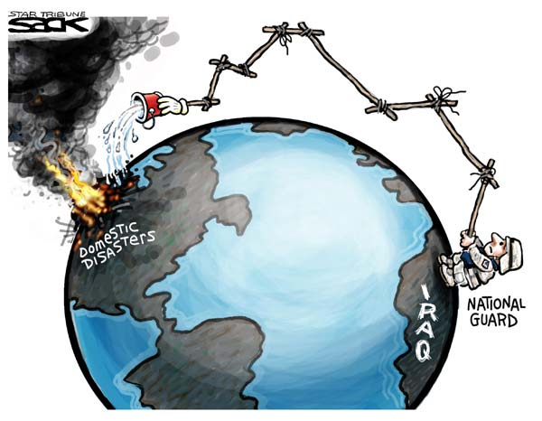
Political Cartoon
Political Cartoons give the reader a view of the ‘thinking of the day’. The cartoon often uses satire to make a point and usually tries to evoke a strong emotional response for one side of the issue.
Steve Sack, Minnesota, The Minneapolis Star-Tribune

Slide 31
Parts of a Newspaper
News story
Editorial
Letters to the Editor
Political Cartoon

Slide 32
Notes:
32

Slide 33

News Writing
Inverted Pyramid
The Inverted Pyramid of news suggests that news be told in order of most interesting or important to least interesting or important
Most interesting or most important
Least interesting or least important

Slide 34
News Writing
Jack and Jill went up the hill to fetch a pail of water.
vs.
Jack suffered a skull fracture and Jill is in serious condition after the pair tumbled down a hill during their ritual water-carrying chores yesterday.

Slide 35
News Writing
The Newark Valley boys’ baseball squad played a game yesterday afternoon.
vs.
The Newark Valley boys’ baseball squad beat Candor at home yesterday in a thrilling extra-inning showdown between neighboring rivals.

Slide 36
News Writing
Most Important
or Interesting
Least Important
or Interesting
Pressconnects.com

Slide 37
Lead Writing
Most journalists think the news lead is the most important part of the news story. It is an art work of concise information that captures the gist of a news story in one or two sentences.

Slide 38
Lead Writing
Depending on the nature of the story and its driving news elements, a lead can focus on one or a few of the six question words:

Slide 39
Lead Writing
Hat Banning: One Story, Six Possible Leads
Who? — The Newark Valley Board of Education members passed a resolution last night banning the wearing of hats in all school district buildings.
What? — Hat wearing was banned in all school district buildings last night after the Newark Valley Board of Education passed a new resolution.

Slide 40
Lead Writing
Where? — In Newark Valley last night, the board of education passed a resolution to ban the wearing of hats in all school district buildings.
When? — Last night, the Newark Valley Board of Education passed a resolution banning hat wearing in all school district buildings.

Slide 41
Lead Writing
How? — By a 6-1 margin last night, the Newark Valley Board of Education passed a resolution banning hat wearing in all school district buildings.
Why? — Citing a pattern of early-onset baldness in Newark Valley teenagers, the board of education last night passed a resolution that restricts hat wearing in all school district buildings.
Pressconnects.com

